Slide 1
Interactive Machine Learning Interface
Lilong Jiang

Slide 2
Motivation
Parameter Tuning
Metrics: Euclidean, Cosine, etc.
For example: K-means: number of clusters, how to initialize
Verify Results
Overfitting, underfitting, etc.
Result is undeterministic: clustering, etc.

Slide 3
Works
K-means: initialize centers, change number of clusters
Linear Regression: adjust linear regression on-line
SVM: try different kernels, features

Slide 4
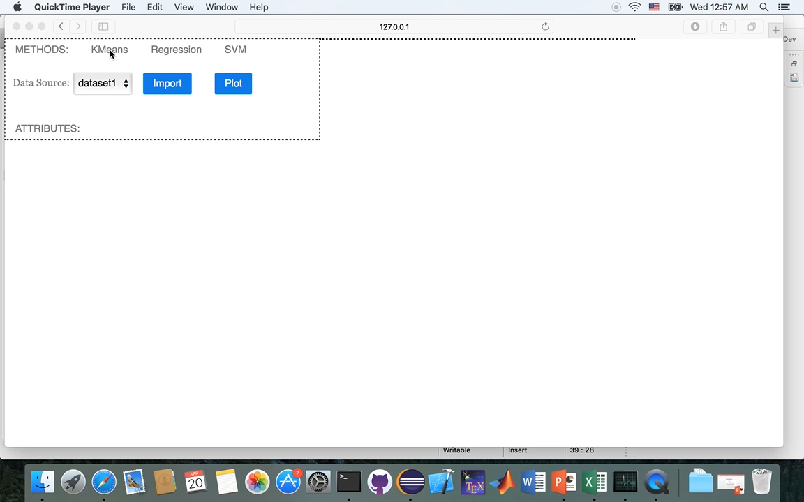
Demo

